Slide 1

A PROJECT ON FACE IDENTIFICATION SYSTEM By Hardik P. Runwal (Rollno 01) (Seat No: 21942 ) Rajal A. Patil (Rollno 02) (Seat No: 21928) Samiksha S. Gaikwad (Rollno 03) (Seat No:21884) UNDER THE GUIDANCE OF Dr N D Karande
DEPARTMENT OF COMPUTER SCIENCE AND ENGINEERING
Sou.Sushila Danchand Ghodawat charitable Trust’s,
SANJAY GHODAWAT GROUP OF INSTITUTIONS

Slide 2
1. INTRODUCTION
Face Identification is a technique that is mainly used to identify criminals based on the clues given by the eyewitnesses. Based on the clues we develop an image by using the image that we have in our database and then we compare it with the images already we have. To identify any criminals we must have a record that generally contains name, age, location, previous crime, gender, photo, etc.

Slide 3
2. LITERATURE SURVEY
EXISTING SYSTEM
There are three major research groups, which propose three different approaches to the face recognition problem. The largest group has dealt with facial characteristics. The second group performs human face identification based on feature vectors extracted from profile silhouettes. The third group uses feature vectors extracted from a frontal view of the face. The first method is based on the information theory concepts in other words on the principal component analysis methods. In this approach, the most relevant information that best describes a face is derived from the entire face image. The second method is based on extracting feature vectors from the basic parts of a face such as eyes, nose, mouth and chin.

Slide 4
PROPOSED SYSTEM
To overcome the drawbacks that were in the existing system we develop a system that will be very useful for any investigation department. Here the program keeps track of the record number of each slice during the construction of identifiable human face and calculate maximum number of slices of the similar record number. Based on this record number the program retrieves the personal record of the suspect (whose slice constituted the major parts of the constructed human face) on exercising the “locate” option.

Slide 5
3. OUTLINE OF PROPOSED WORK
ALGORITHM FOR CLIPPING

Slide 6
Start
Login
Authentication
Valid User
Invalid User
Main Screen
Add Image
Clip Image
Update Details
Construct Image
Search Process
Enter Details
Open Image& Make Clips
Open Record & Update
Specify Feature
Search Image & Get Details
Add to Database
Add Clips to Database
Add to database
Search Image
Result
End

Slide 7
4. LIST OF MODULES
ADD IMAGE
Add Image is a module that is considered with adding image along with the complete details of the person of whom we are taking image. In this we add Image by importing from the Internet and store them in our system and database. This module is mainly considered for adding details of the criminals like name, age, alias name, gender, location, state, Arrested Date, etc. At the time of the adding image we give some criminal id to that particular person, so that it can be easily added to the database without any duplication of the data.
CLIP IMAGE
This modules main function is to divide the images into different pieces such as hairs, forehead, eyes, nose and lips and store them in the database and also creates the files onto our system.

Slide 8
CONSTRUCT IMAGE
Based on the eyewitnesses we are going to construct the images. The witness will give us instruction by looking onto the screen on which there will be the parts of the images like eyes, hairs etc.
IDENTIFICATION
This module contains the interface to take the image from above module and it compares or searches with the images already there in the database. If any image is matched then we identify him/her as the criminal else we add that new image again to the database.

Slide 9
5. REQUIREMENT SPECIFICATION
Hardware Requirements:
System with standard configuration.
Software Requirements:
Operating System : Windows
Database Server : Oracle 9i
Programming Language : Java
Frame Work : Swing

Slide 10

6. EXPERIMENTAL RESULTS
1 Login
To authenticate valid user the system is provided with user name and password.

Slide 11
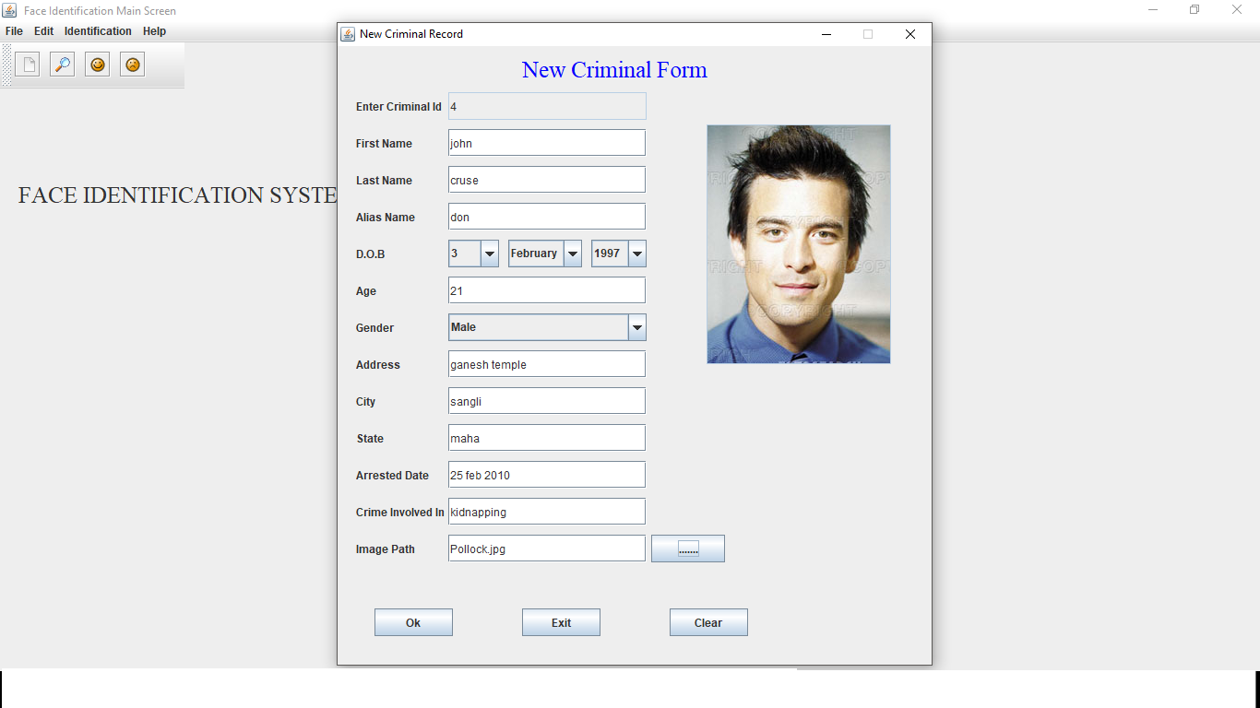
New Criminal Record
Insertion of new criminal records along with the details of the criminal like the name, age, city, crime committed.

Slide 12
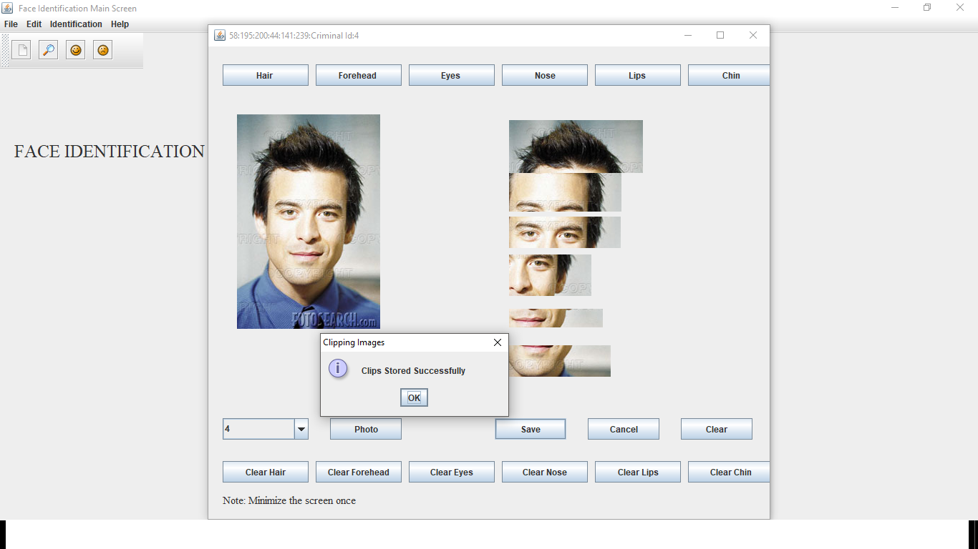
Image Clipping
It divides the images into different pieces such as hairs, forehead, eyes, nose and lips and store them in the database.

Slide 13
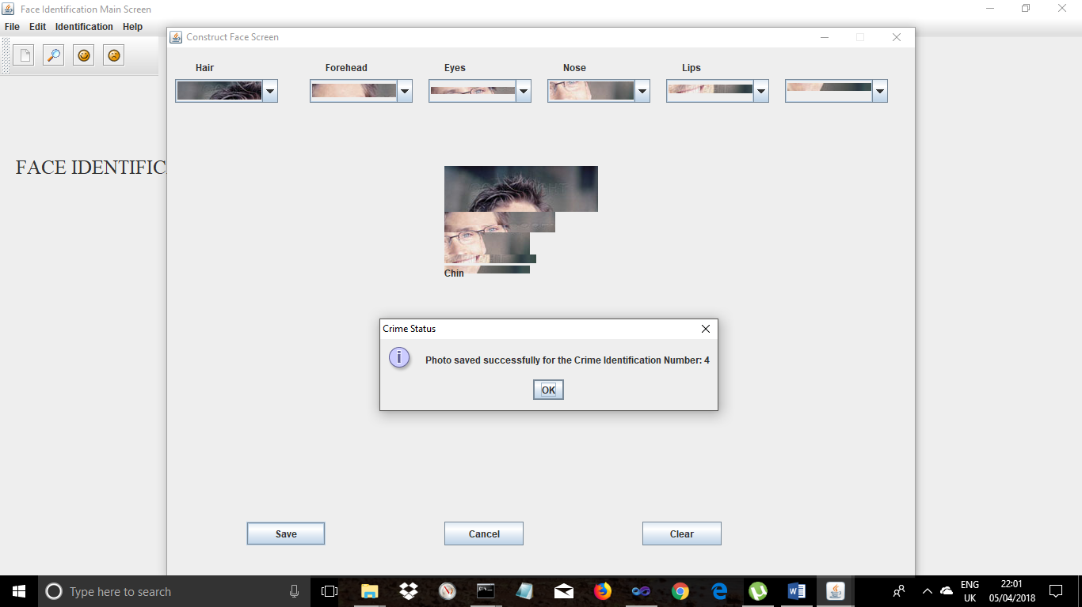
Clipped Images are constructed
Based on the eyewitnesses we are going to construct the images. The witness will give us instruction by looking onto the screen on which there will be the parts of the images like eyes, hairs etc.

Slide 14
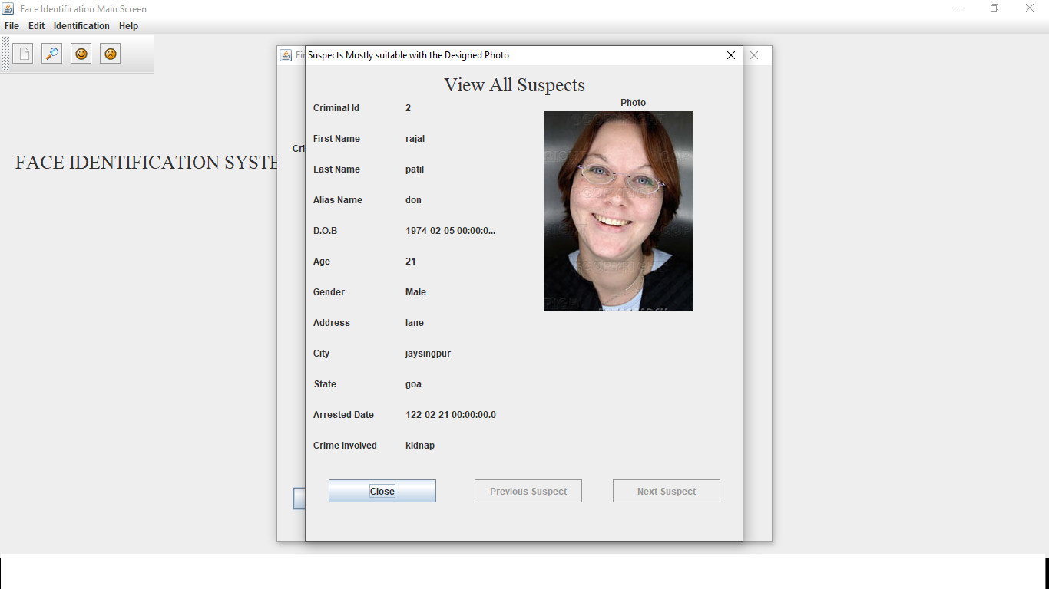
Possible suspect
If any image is matched then we identify him/her as the criminal else we add that new image again to the database.

Slide 15
7. CONCLUSION
Conclusion
The purpose of face identification system is to identify criminals. In past years this process is carried out by humans. This process gives the exact image of the criminal but it is very difficult to identify the criminal details and also it requires much amount of human burden.
The main aim of our project is to overcome the drawbacks of human based system by using the machine based face identification process. In this process we store the details of criminal into the database along with his photo or image. Then we make the image into different clips containing hair, forehead, eyes, nose, lips and chin and store these clips into the database. When any crime occurs we compare the details given by the eyewitness with the clips already stored in the database and we will identify the criminal.
FUTURE SCOPE.
The future perspective of our project can be linking our face identification system with hardware like web cameras so that even a moving face can be captured and identified. Other than this the percentage of matching of image can also be found out .

Slide 16
8. REFERENCES
”The Complete Reference Java2” Tata McGraw-Hill publishing Company Limited. By Herbert Schildt.
“Software Engineering, A Practitioner’s Approach” Tata McGraw-Hill Publishing Company Limited. By Roger S. Pressman.
L.C Jain, ‘‘intelligent technique in face recognition.’’ Boca Raton: CRC Press, 1999.
Aurelio Campilho, MohamdKamel, “image analysis and recognition: international conference, ICIAR 2004.
Face Recognition: Cognitive and Computational Processes: Sam S. Rakover and Baruch Cahlon.

Slide 17
THANKYOU

